Slide 1
Introduction to Computing (Nhập Môn Công Nghệ Thông Tin)
Lectured by: FCS Faculties
(Course’s website: TBU)

Slide 2
Course Details
Number of credits: 2 (1+1)
Study time allocation per week
3 lecture hours for theory
3 lecture hours for lab work
6 hours for self-study
Textbook:
Foundations Of Computer Science, 3rd ed., Behrouz Forouzan, 2018

Slide 3
Assessment
Learning behavior (thái độ)
Attendance (Chuyên cần): 5%
Participating in activities (exercises, homework, …) (Ý thức làm bài tập): 5%
Mid-term exam (questions & practices): 30%
Final Exam (questions & practices): 60%
Absences > 20%: Not eligible for final exam
(Nghỉ học quá 20% số buổi sẽ không được thi cuối kỳ)

Slide 4
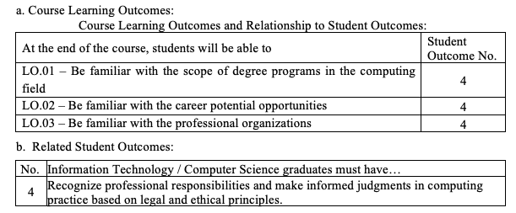
Learning Outcomes
This course overviews the computing field to students; also included are topics in social and ethical issues. The lab topics include an overview of computers and programming; problem-solving and algorithm development; simple data types; arithmetic and logical operators; selection structures; text files; arrays; some useful tools for CS & IT study (using linux OS, version control, search engine, editors…).

Slide 5
Course Topics
Introduction
Data representation and operation
Computer hardware
Computer Networks and Internet
Operating systems
Algorithms & Programing
Databases
Security
Social and Ethical Issues

Slide 6
Lab Topics
Lab 1: Linux Operating System
Lab 2: Practice with Google search & Prompting ChatGPT
Lab 3: Programming (Python) => Jupyter Notebook
Lab 4: Version Control (Git)
Lab 5: Extra

Slide 7


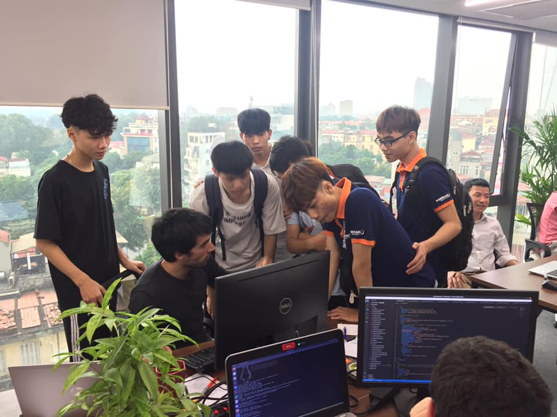
Enterprise Experience (Trải nghiệm DN)
One day visit companies in IT/CS field

Slide 8
Q & A

